Slide 1

radly: Your MBA Buddy
g
A Conversational AI for Academic and Career Excellence

Slide 2
Academic Overload
Uncertainty in Career Path
Uncoordinated Placement Prep
Inefficient Learning Reflection
Absence of Personalized Guidance
Juggling multiple subjects, deadlines, case readings, and group projects
Scattered resources for CVs, mock interviews, and industry prep
Lack of introspective tools to understand personal inclinations
Generic workshops can't replace tailored mentorship
No streamlined feedback or self-awareness mechanisms
PROBLEM STATEMENT

Slide 3
CONTINUOUS LEARNING &
FEEDBACK LOOP
Component | Details
Target Market | Tier-1 MBA students, across 1st and 2nd year
Core Offering | Chatbot-enabled academic and career assistant
Supplementary Services | Career Diagnostics, project mentoring, case walkthroughs
Delivery Mechanism | Web and Mobile platform with smart dashboards
Service outcome | Informed Career clarity, academic excellence, self-driven growth
Other features
Weekly prompts in the Reflection Room
Auto-logged mentor & professor feedback
CV and interview feedback loop
Mood-based journaling for tracking confidence and burnout
Dashboard visualizations show “Clarity Curve” and “Goal Alignment Index”
Adaptive learning suggestions based on performance metrics
SERVICE CONCEPT
Conversational AI Chatbot
Responds to academic doubts, mock interview prompts, and resume suggestions
Personalized Student Dashboard
Tracks career goals, academic tasks, and self-growth metrics
Career Psychology Lab
Tools like Career Anchor, Strong Interest Inventory, CDMD, Virtual Card Sort
Resume & Interview Coach
Automated resume scans + STAR story builder + mock interviews
Project & Case Companion
AI-guided frameworks and ideation for business cases
Industry Playbooks
Tailored prep for consulting, finance, marketing, and product roles
Reflective Room
Weekly journaling prompts and mood-based productivity logs
Peer Benchmarking Tool
Anonymous insights on peer performance and prep trajectory
KEY FEATURES

Slide 4

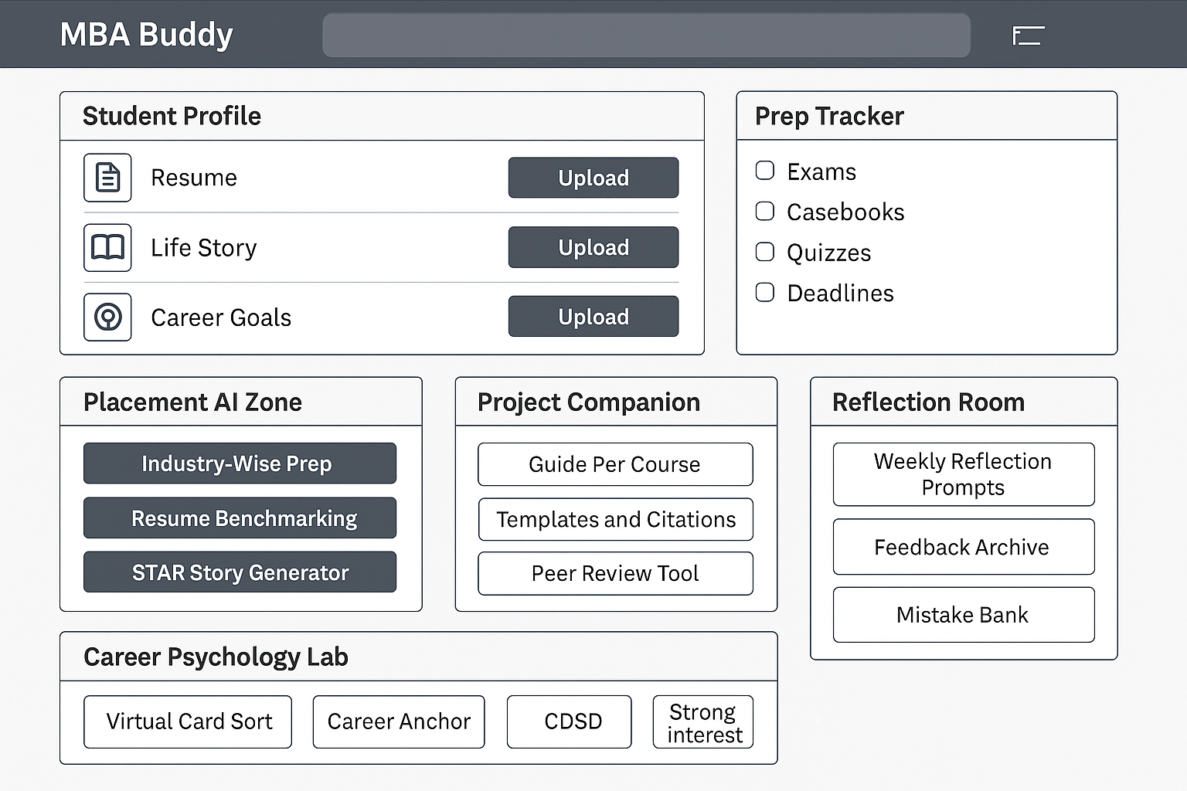
GRADLY
CDMD

Slide 5

Introducing your Plot Recruiter—an AI assistant designed specifically for Gradly users to help you excel in your placement interview preparation. Simply provide the job description you've received, and the Assistant will leverage your existing user data to tailor its guidance. It will prepare you for interviews by simulating sessions from the perspective of the company's recruiter, ensuring that all practice aligns closely with the requirements of the job description. Enjoy unlimited, personalized mock interviews to build your confidence and readiness.

Slide 6
Layer | Details
Customer Actions | Interacts with the onboarding wizard → | Uploads resume → | Sets career goals → | Takes diagnostic tests → | Initiates academic queries or placement simulations → | Receives AI feedback → | Reflects on learning using the journaling tool
Frontstage (Visible Contact Points) | MBA Buddy AI Chatbot (text + voice-enabled) → | Custom Dashboard Interface → | Career Test Results & Visuals → | STAR Story Generator → | Case Crackers → | Weekly Reflection Prompts → | Email nudges & mobile notifications
Backstage (Invisible Contact Employee Actions) | AI/NLP Engine processes inputs → | Adaptive Learning Engine matches responses to career anchors & job domains → | Dynamic dashboard updates → | Data-driven recommendation generator (case books, frameworks, industry guides)
Support Processes (Enabling Systems) | Psychometric test API integrations (Strong Interest Inventory, CDMD, Career Anchors) → | Resume parsing tools (integrated with ATS standards) → | LMS and LinkedIn APIs → | Secure cloud storage (AWS) for user data → | ML models for pattern tracking & improvement
Physical Evidence (Tangibles in Service) | Student Dashboard (Web + Mobile UI) → | Test Report Cards → | Resume Diagnostic Summary → | Interview Transcript Logs → | Career Progress Timeline → | Visualized Goal-Achievement Heatmaps
SERVICE BLUEPRINT
Lines of Interaction
Line of Visibility
Line of Internal Interaction
Managed through synchronous communication between AI models and learning analytics databases
Clearly separates front-end guidance from back-end intelligence systems
Defined via user interface & chatbot entry points

Slide 7
CUSTOMER JOURNEY MAP
Phase | Touchpoints | User Objective | Gradly Service Response
Awareness | Learns about MBA Buddy via B-school orientation/peer reference | Understand MBA Buddy’s value | Short explainer video, landing page, and feature demo
Onboarding | Creates profile, uploads resume, inputs goals | Establish a baseline & personal context | Dynamic dashboard generation, goal alignment tracker
Self-Discovery | Takes Career Anchor Test, CDMD, Card Sort, Interest Inventory | Discover ideal job roles & working styles | Personalized test feedback, domain matching, summary report
Academic Support | Requests help on a concept, a case, or a project | Excel in class prep and submissions | Case breakdowns, concept explainers, real-time answers
Placement Preparation | Uses STAR builder, interview simulator, resume checker | Boost confidence for internships & jobs | Interactive AI roleplays, domain-specific Q&A banks
Reflection & Feedback | Journals weekly, logs learnings, views mentor feedback | Internalize learning, build awareness | Reflection prompts, skill radar maps, emotion tags
Post-Placement Growth | Tracks job offers, explores certifications | Upskill post-offer, plan ahead | L&D suggestions, book recommendations, cohort-based upskilling challenges

Slide 8
Competitive Advantage
Holistic Integration: One platform for academic, placement, and personal growth
Investment and Feasibility
Breakeven: Within 1 academic year via B2B SaaS licensing
AI + Human Design: Conversational bot + personalized dashboards
Career Psychology Differentiator: Few tools offer Strong Inventory + CDMD + Card Sort together
Data-Driven: Tracks progress and behavior to deliver tailored insights
First-Mover in end-to-end MBA lifecycle services
Scalability: Plug-and-play model for B-schools
Feasibility: High, using modular development and third-party APIs
Revenue Model: Subscription (institutes or students), Freemium with AI unlocks
PERFORMANCE INDICATORS
Objective | KPI
Reliability | Chatbot accuracy > 90% in resolving queries
Responsiveness | Real-time resume feedback < 30 sec
Personalization | 80%+ engagement with personalized prep plans
User Satisfaction | NPS > 75 among pilot group
Career Clarity Uplift | Pre vs Post-test clarity scores increase by 35%

Slide 9
Design Thinking Framework
Empathize: Daily lives of MBA students
Define: Gaps in career clarity and structured prep
Ideate: Bundling AI, diagnostics, and dashboards
Prototype: UI/UX mock ups and bot trials
Test: Controlled pilot runs with user feedback
IHIP Characteristics
Intangibility: Delivered digitally
Heterogeneity: Personalized pathways
Inseparability: Learning and interaction together
Perishability: Dynamic feedback and timely

Slide 10
THANK YOU
Group 1

